Slide 1

User Experience
Otniel Yosi Viktorisa
Product Developer Team Lead at PT. Altrovis Tekno Global
otniel.y.viktorisa@gmail.com

Slide 2
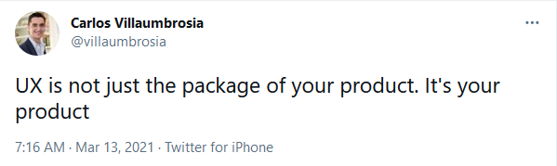
What is UX
All the interactions between a customer and your business, online and offline, at any time

Slide 3
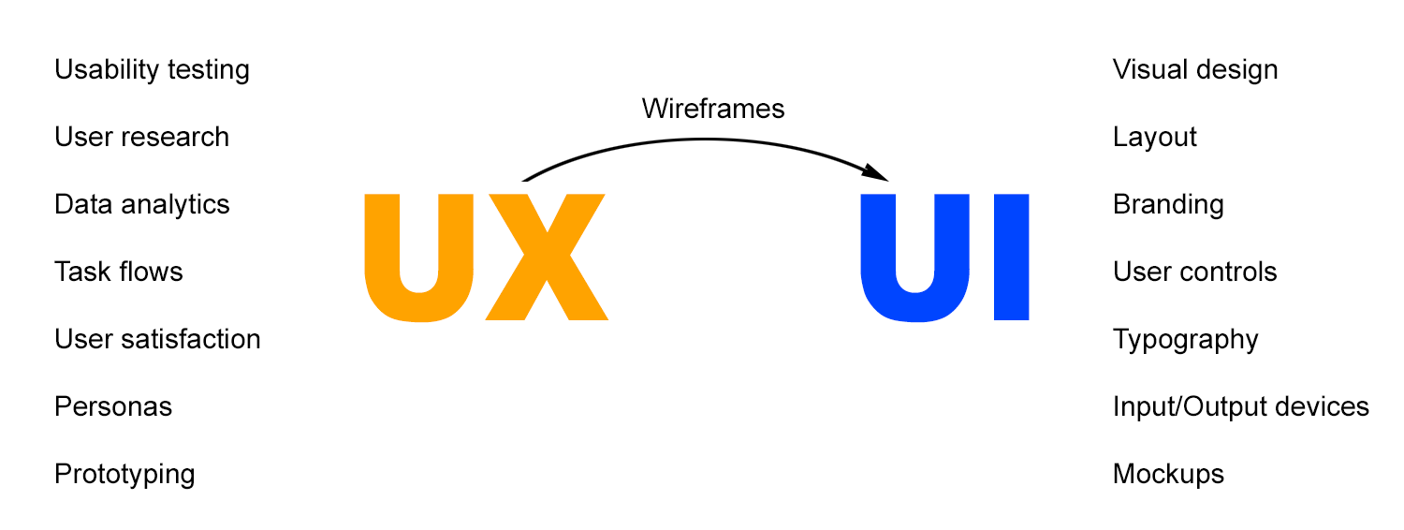
What is UX
Image:https://growthoutfitter.com/whats-the-difference-between-ux-and-ui/

Slide 4
UX Design
A process describing lots of different activities
Minimising pain points in the journey
Increasing engagement and profits

Slide 5
UX Design Lifecycle
Discover user & relevant product
Describe concept
Design behaviour
Develop design
Release
+ continual improvement

Slide 6
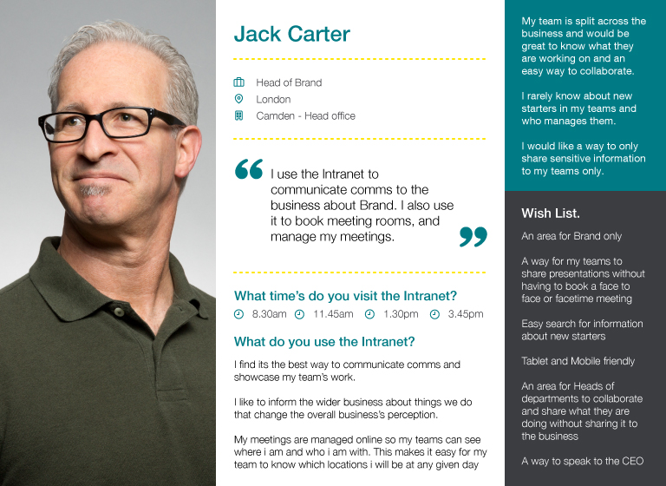
Discover user
User research
User feedback
Creating personas
image:https://hinahirani.wordpress.com/2018/05/09/ee-ux-ui-intranet/

Slide 7
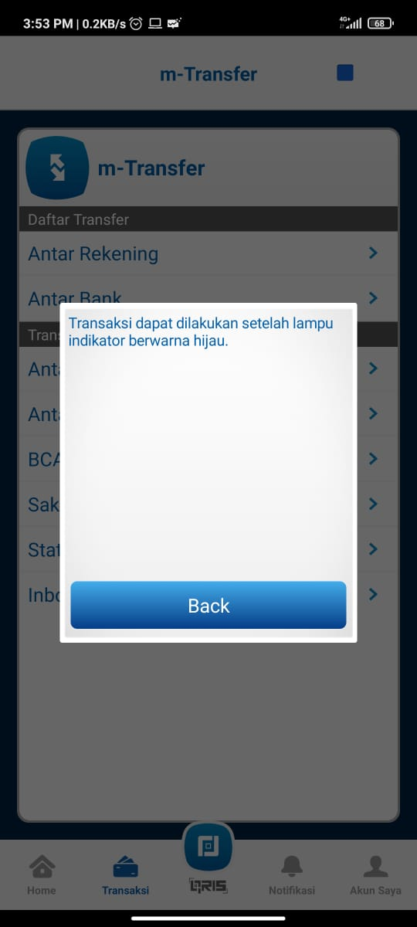

Slide 8
Describe concept
Define goals -> brainstorm ideas -> define requirements
Find balance between what is feasible and what is needed

Slide 9
Designing the Experience
Creating user journey
+ Think logically and be very clear about what’s necessary and in what orders things happen
+ Think about alternate paths, not only happy path
Creating visual design
Designing information architecture

Slide 10
Good Usability
Simple and easy to understand
Intuitive
Engaging
Efficient
Well-supported
Easy to recover
Consistent

Slide 11
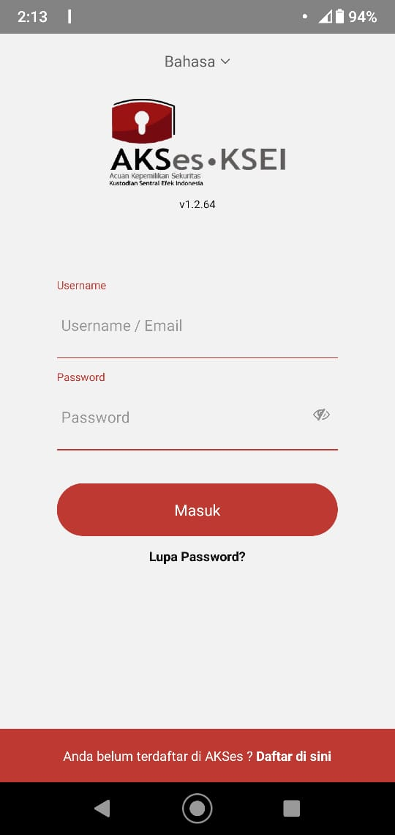
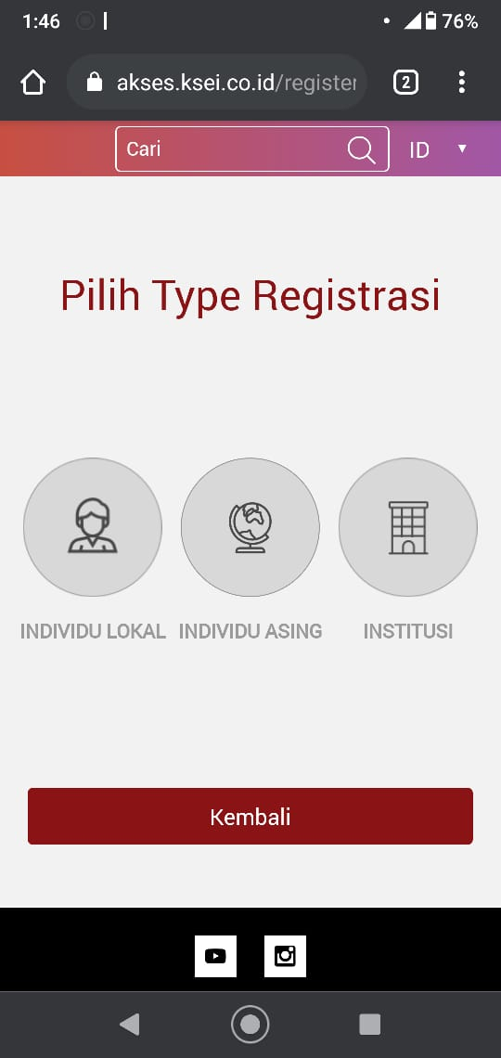
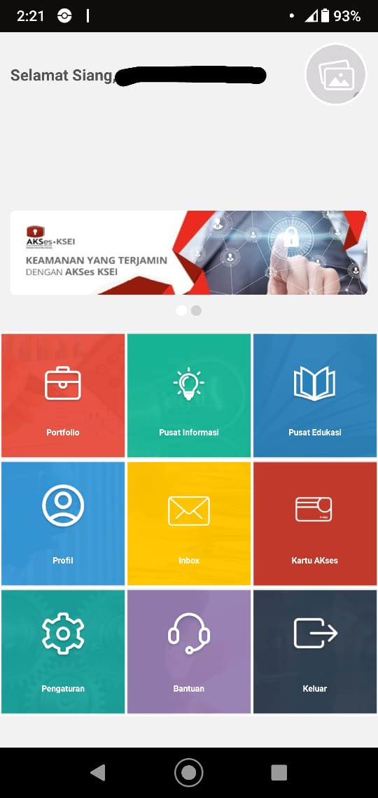
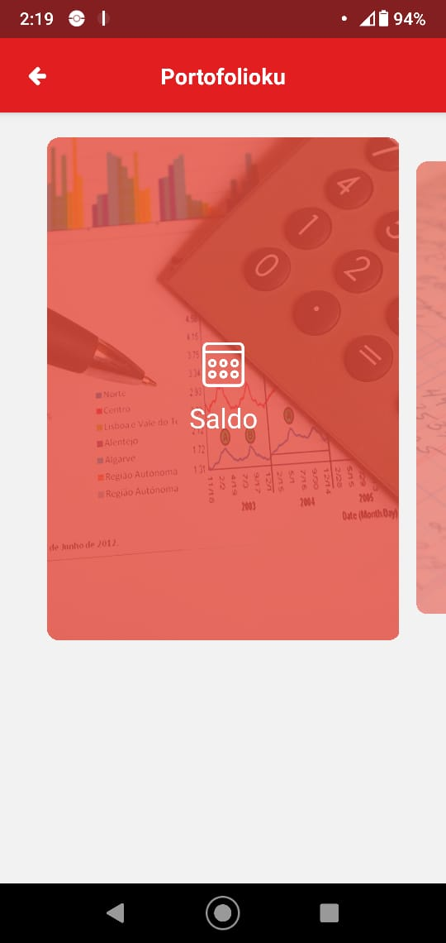
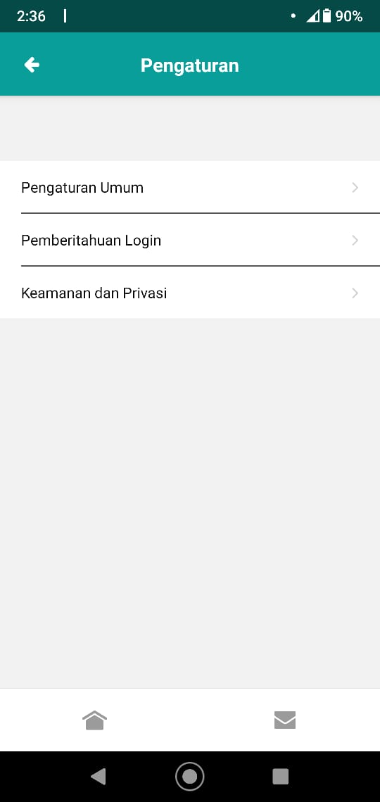

Slide 12
Developing Design
Prototyping
User testing

Slide 13
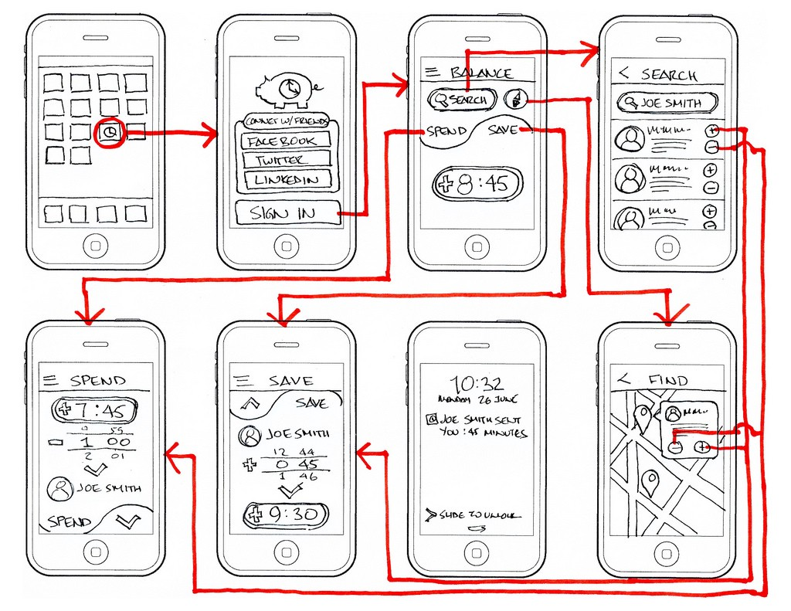
Prototyping
A model or mock-up
To experiment, to test, and communicate your ideas (usability)
Starting with low fidelity
image:https://blog.prototypr.io/why-you-shouldnt-skip-your-wireframing-1f7a70d5c125

Slide 14
User Testing
Lets real people mimic exactly what will happen on your product
Take user feedback and enhance your creation
task-based testing
real world testing
guerrilla testing
diary testing
A/B testing

Slide 15
Release
Collect and continually review data
Define data points

Slide 16
UX Mobile vs Desktop
Different size
Different input/output
Different interaction
and so on

Slide 17
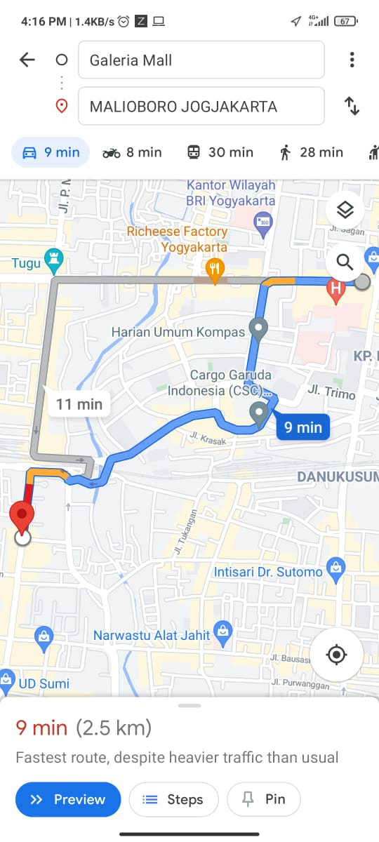
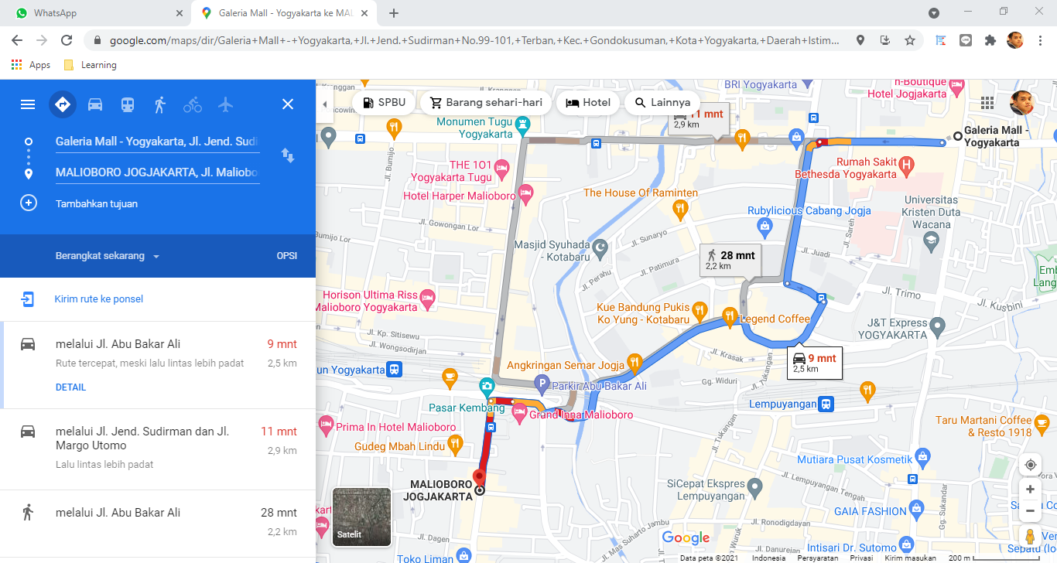
A smartphone app may offer less or extra functionality than the desktop version
Even when software has the same functionality, it can be implemented in very different ways

Slide 18
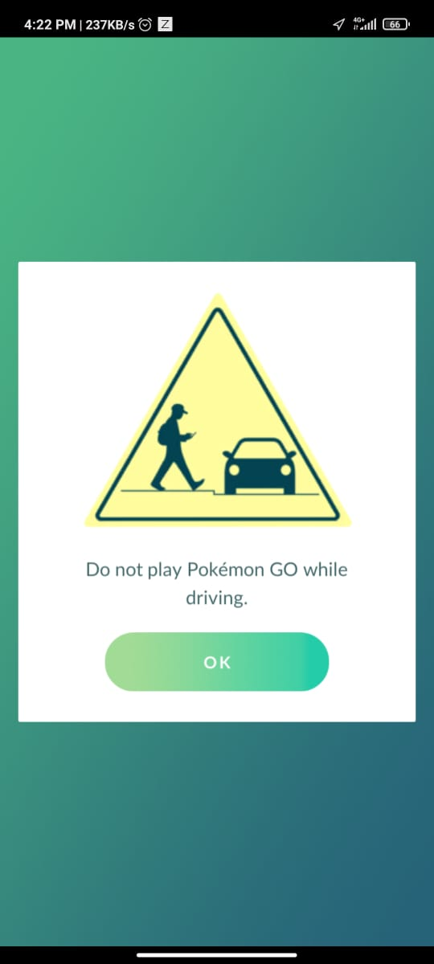
Things to consider
User condition
User situation
User environment

Slide 19
Reference and Further Learning
Digital Skills : User Experience course by Accenture (https://www.futurelearn.com/courses/digital-skills-user-experience)
Creating a Great User Experience for Mobile Apps course by University of Leeds (https://www.futurelearn.com/courses/creating-a-great-user-experience-for-mobile-apps)

